Slide 1
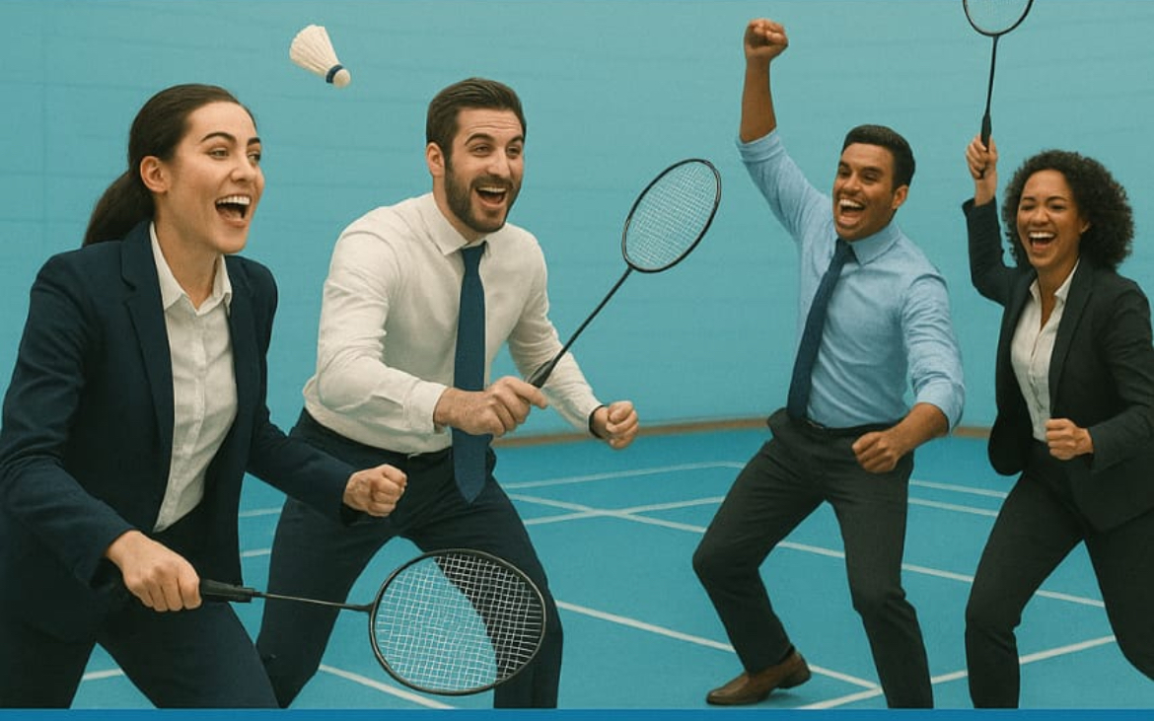
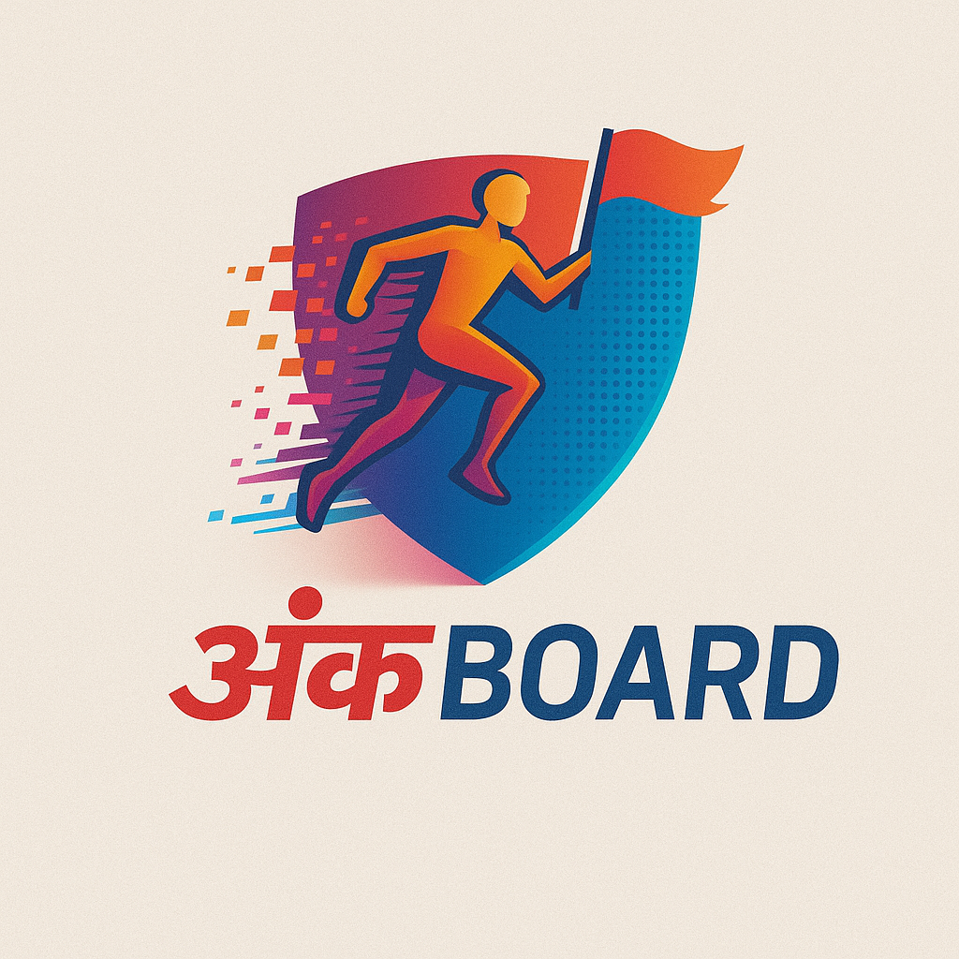
Co-Baddy Battle League
#The Ultimate Corporate Badminton Showdown for Professionals
PRESENTED BY

Slide 2

Co-Baddy Battle League Overview
We’re thrilled to invite your organization to participate in the Co-Baddy Battle League, a high-energy badminton tournament designed for corporate professionals. This exciting event will offer opportunities to compete, network, and have fun, all while showcasing your athletic skills in a friendly environment. It’s League Style Tournament, which gives additional chance to come back. Its worth It:-
Fitness Focused
Network Opportunities
A healthy Day Out with your team
Affordable, energetic and unforgettable - don’t miss it

Slide 3

Team Composition
To ensure a dynamic and inclusive competition, each team
must consist of 5 to 7 players, with a minimum of 2 female players.
This structure promotes teamwork and diversity, allowing corporate professionals to engage and collaborate while enjoying the spirit of badminton.

Slide 4
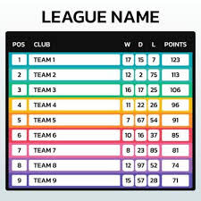

Tournament Format:
Group Stage and Knockout Rounds
The Co-Baddy Battle League features a competitive structure, starting with group-stage league matches known as ‘Ties’. its Round-Robin Stage: Each team plays ties against each team during the league stage.
Each Tie includes five matches:
🏸Women’s Singles
🏸Men’s Singles
🏸Mix Doubles
🏸Men’s Doubles
🏸Women’s Doubles.
Top teams of groups will progress to the knockout rounds, culminating in an exciting championship final.

Slide 5

Champion & Runner-Up Rewards
Participants will compete for exciting prizes that elevate the spirit of the tournament.
The Champion team will receive
₹18,000
Prestigious Trophy,
Medals for every winner
The Runner-Up team will take home
₹15,000
Trophy,
Medals of every team member
Join us to showcase your skills and claim these fantastic rewards!

Slide 6



Event Highlights: Connect, Refresh, and Enjoy
NETWORKING OPPORTUNITIES
Forge new connections
HEALTHY REFRESHMENTS
Stay energized and hydrated
FUN ACTIVITIES
Engage in friendly competition

Slide 7




Event Details
InfintinyS badminton Academy Sector 110, Dwarka Expressway Gurgaon
2nd Nov. 2025 (Sunday)
Team Registration Fees: ₹7,200 which comes down ₹1,028 per player.
Registration process:
1- Captain would Register himself/herself and team through
https://forms.gle/gujFC2h9Mvp6EeuK8
2- Once Team is Registered after the validation by Organizing team, Organizing team would share another link to captain to register the team player.

Slide 8

Recap of the Co-Baddy Battle League Experience
The Co-Baddy Battle League promises not just intense sport but also valuable networking opportunities and a chance to bond over shared experiences. Participants will leave with unforgettable memories, connections, and the spirit of camaraderie, making it a highlight of the corporate calendar.

Slide 9



We look forward to seeing you!
Join us for an unforgettable experience in corporate badminton and networking opportunities.
Ankboard.com
info@ankboard.com
9891044982

Slide 10
Co-Baddy Battle League
#The Ultimate Corporate Badminton Showdown for Professionals
PRESENTED BY

